Slide 1

Authentication & Authorization
Final Term Project
ENPM693 – Network Security / 0101

Slide 2
What is Authentication?
Verifying the identity of a user, process, or device often as a pre-requisite to allow access to resources in an information system.

Slide 3
The authentication mechanism should be at least one of the following:
Something you know Something you are Something you have

Slide 4
Multi-Factor Authentication
By leveraging at least two of the methods mentioned previously, a multi-factor authentication is implemented. It provides additional trust to the system.

Slide 5
Weaknesses in Authentication
The following can lead to authentication bypass vulnerabilities:
- Poor authentication mechanism and implementation
- Weak passwords
- Weak identity mechanisms
- Poor password policies and storage practices

Slide 6
CWE-307: Improper Restriction of Excessive Authentication Attempts
- Description: The software does not implement sufficient measures to prevent multiple failed authentication attempts within in a short time frame,
making it more susceptible to brute force attacks
- You: “You tried to sneak past without speaking ‘friend’ to enter…”
- Attacker: “Oh well.. I’ll just try that again...”

Slide 7
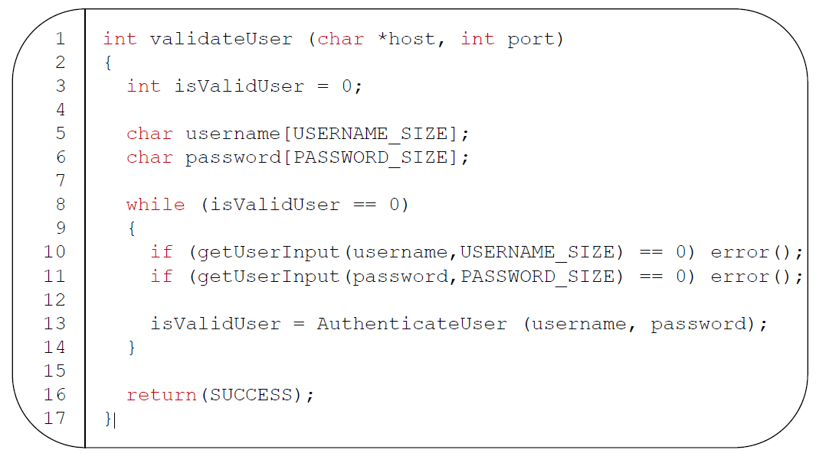

Slide 8
CWE-521: Weak Password Requirements
- Description: The product does not require that users should have strong
passwords, which makes it easier for attackers to compromise user
accounts.
- Authentication mechanisms often rely on a memorized secret (also known
as a password) to provide an assertion of identity for a user of a system. It
is therefore important that this password be of sufficient complexity and
impractical for an adversary to guess.
- The specific requirements around how complex a password needs to be
depends on the type of system being protected. Selecting the correct
password requirements and enforcing them through implementation are
critical to the overall success of the authentication mechanism.

Slide 9
What is Authorization?
The right, permission, or privilege granted to system entity to access a system resource or functionality.

Slide 10
While implementing Authorization, one should always ask the following questions:
- What level of access to software system resources or functionality is necessary for the user or entity?
- If it is role based, are they granular enough to support only the necessary functionality?

Slide 11
Weaknesses in Authorization
Authorization bypasses can occur in many ways:
- Authorization checks are either absent or not implemented correctly
- Not all resources are protected with authorization checks
- A confused deputy is used to provide authorization to resources that otherwise was unavailable to an attacker

Slide 12
CWE-425: Direct Request ('Forced Browsing')
- Description: The web application does not adequately enforce appropriate authorization on all restricted URLs, scripts, or files.
- Web applications susceptible to direct request attacks often make the false assumption that such resources can only be reached through a given navigation path and so only apply authorization at certain points in the path.
- Don’t use the term ‘forced browsing’ since it can have multiple contexts.
- Essentially the software system allows an unauthorized user to access resources (like pages) when directly browsed to it by a user because it is missing an authorization check or the routing for authorization has not been implemented correctly.

Slide 13
CWE-639: Authorization Bypass Through User-Controlled Key
- Description: The system's authorization functionality does not prevent one user from gaining access to another user's data or record by modifying the key value identifying the data.
Assuming:
- Resources are retrieved using ‘keys’ (that implicitly act as intermediary authorization tokens)
Because/And:
-The authorization process does not properly check the entitlement or privileges of accessing that resource for a specific user/role or entity.
Then
-This allows for (potentially not necessarily) another user to access another user’s resource on the software system just by using the ‘key’.

Slide 14
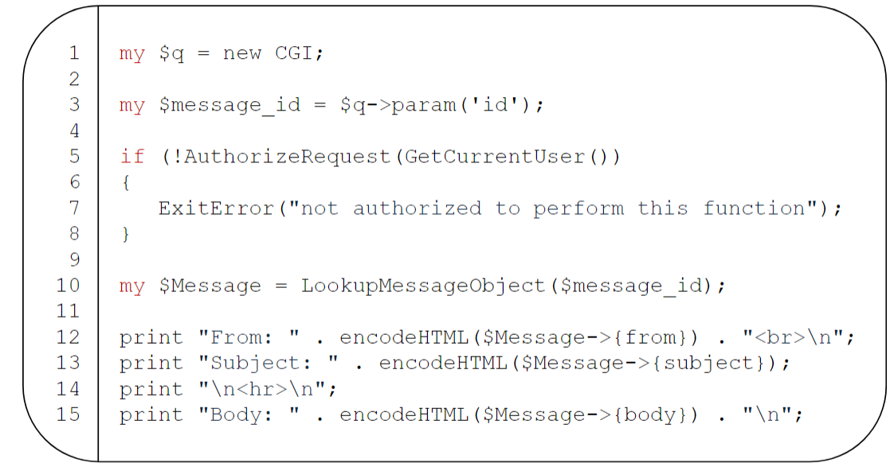

Slide 15
Syed Mohammad Ibrahim
iamibi@umd.edu
UID: 118428369

